Slide 1
Technical Update Details - About Sensor
Capstone Design 2025-1, Team A#
2025.05.01 Week 09
Presenter : 이진성

Slide 2
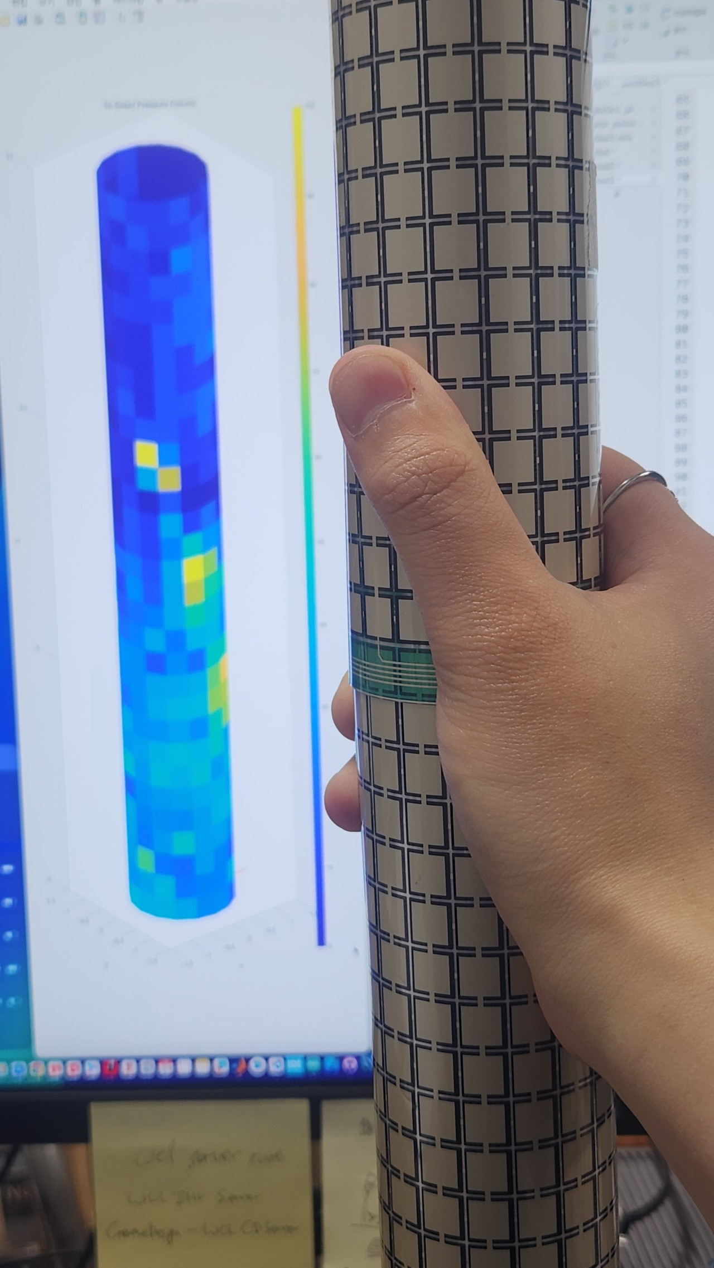
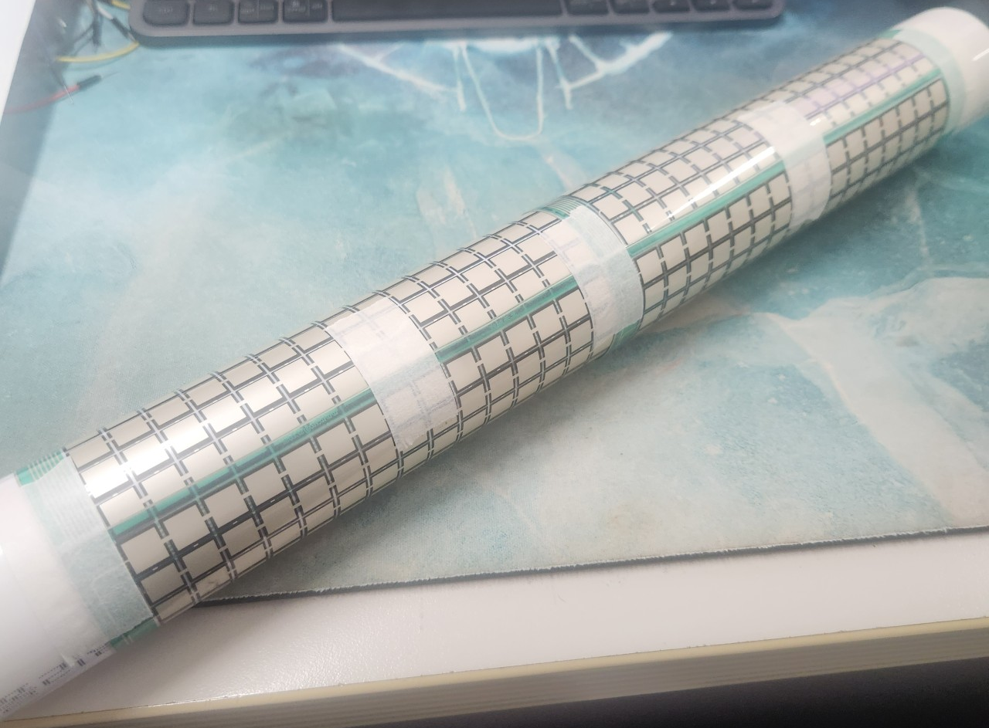
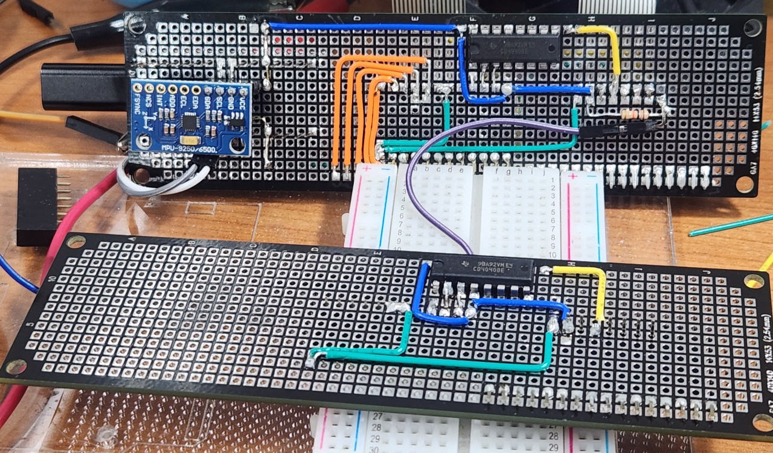
1. FSR Bar

Slide 3
Dual FSR Matrix sensor
16x16 FSR Matrix
16x16 FSR Matrix
Y0
Y15
I0
I15
Y0
Y15
I0
I15
4-to-16 Decoder
16-to-1 Mux
4-to-16 Decoder
16-to-1 Mux
Output
Output
A2
A2
A1
A0
S3
S2
S1
S0
A2
A2
A1
A0
S3
S2
S1
S0
Q7
Q6
Q5
Q4
Q3
Q2
Q1
Q0
Q7
Q6
Q5
Q4
Q3
Q2
Q1
Q0
8-bit Counter
8-bit Counter
CLR
CLK
CLR
CLK
MCU
DO1
DO2
AI0
AI1

Slide 4
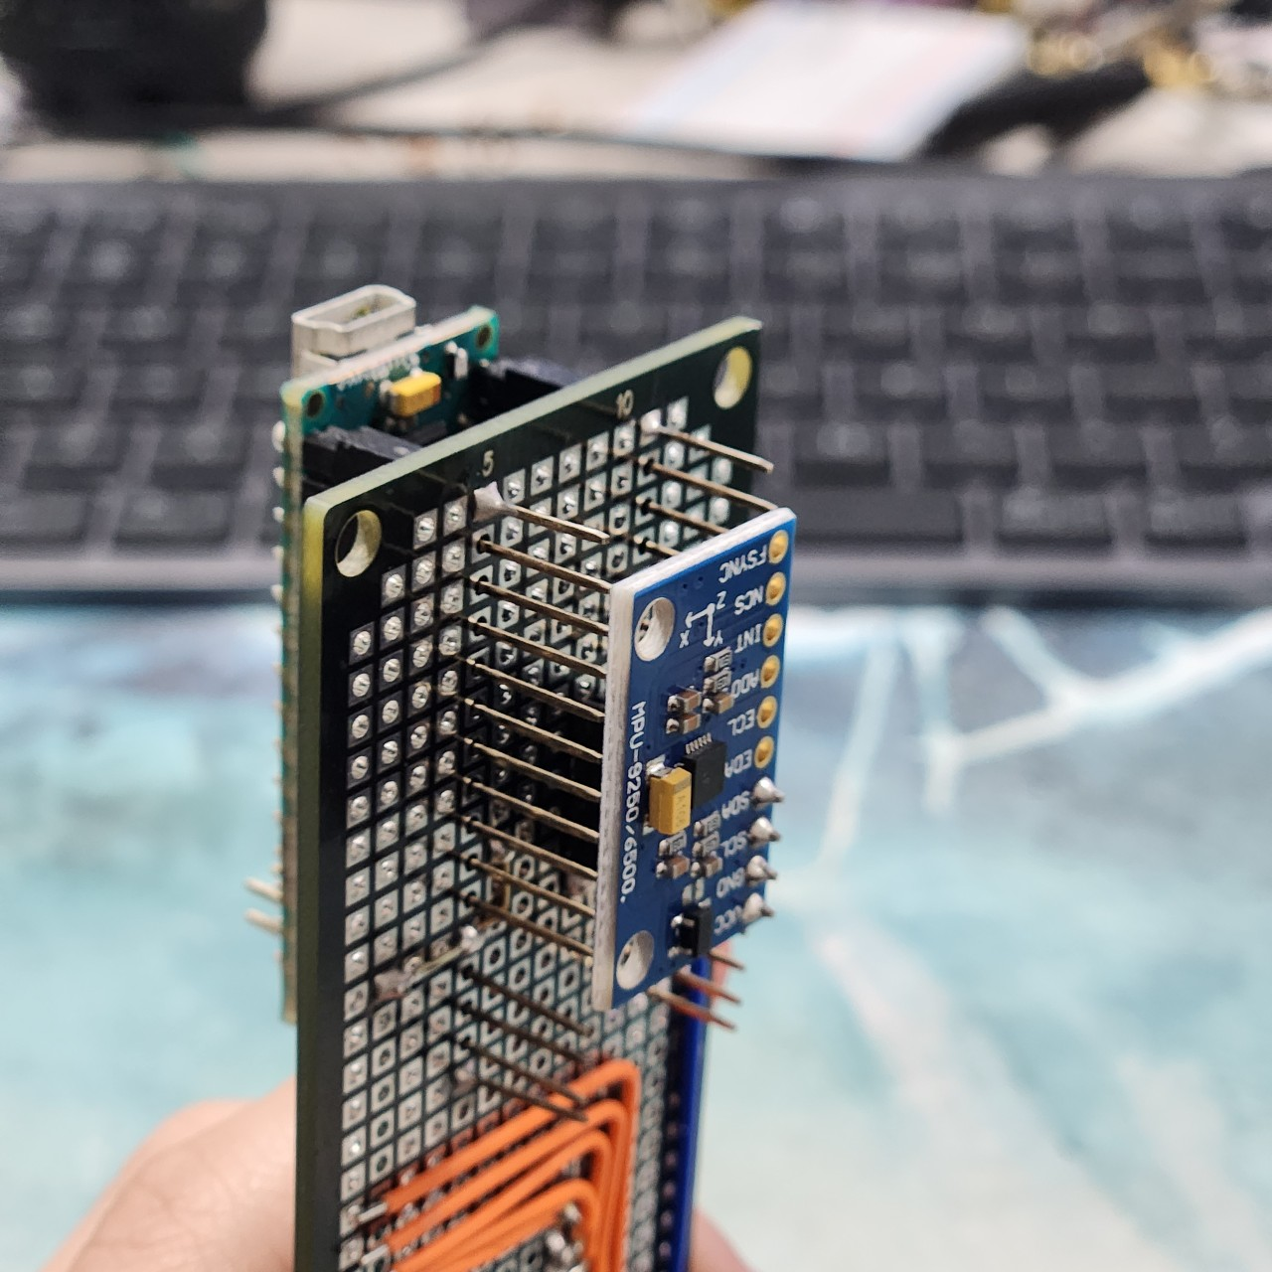
Gyro Sensor

Slide 5
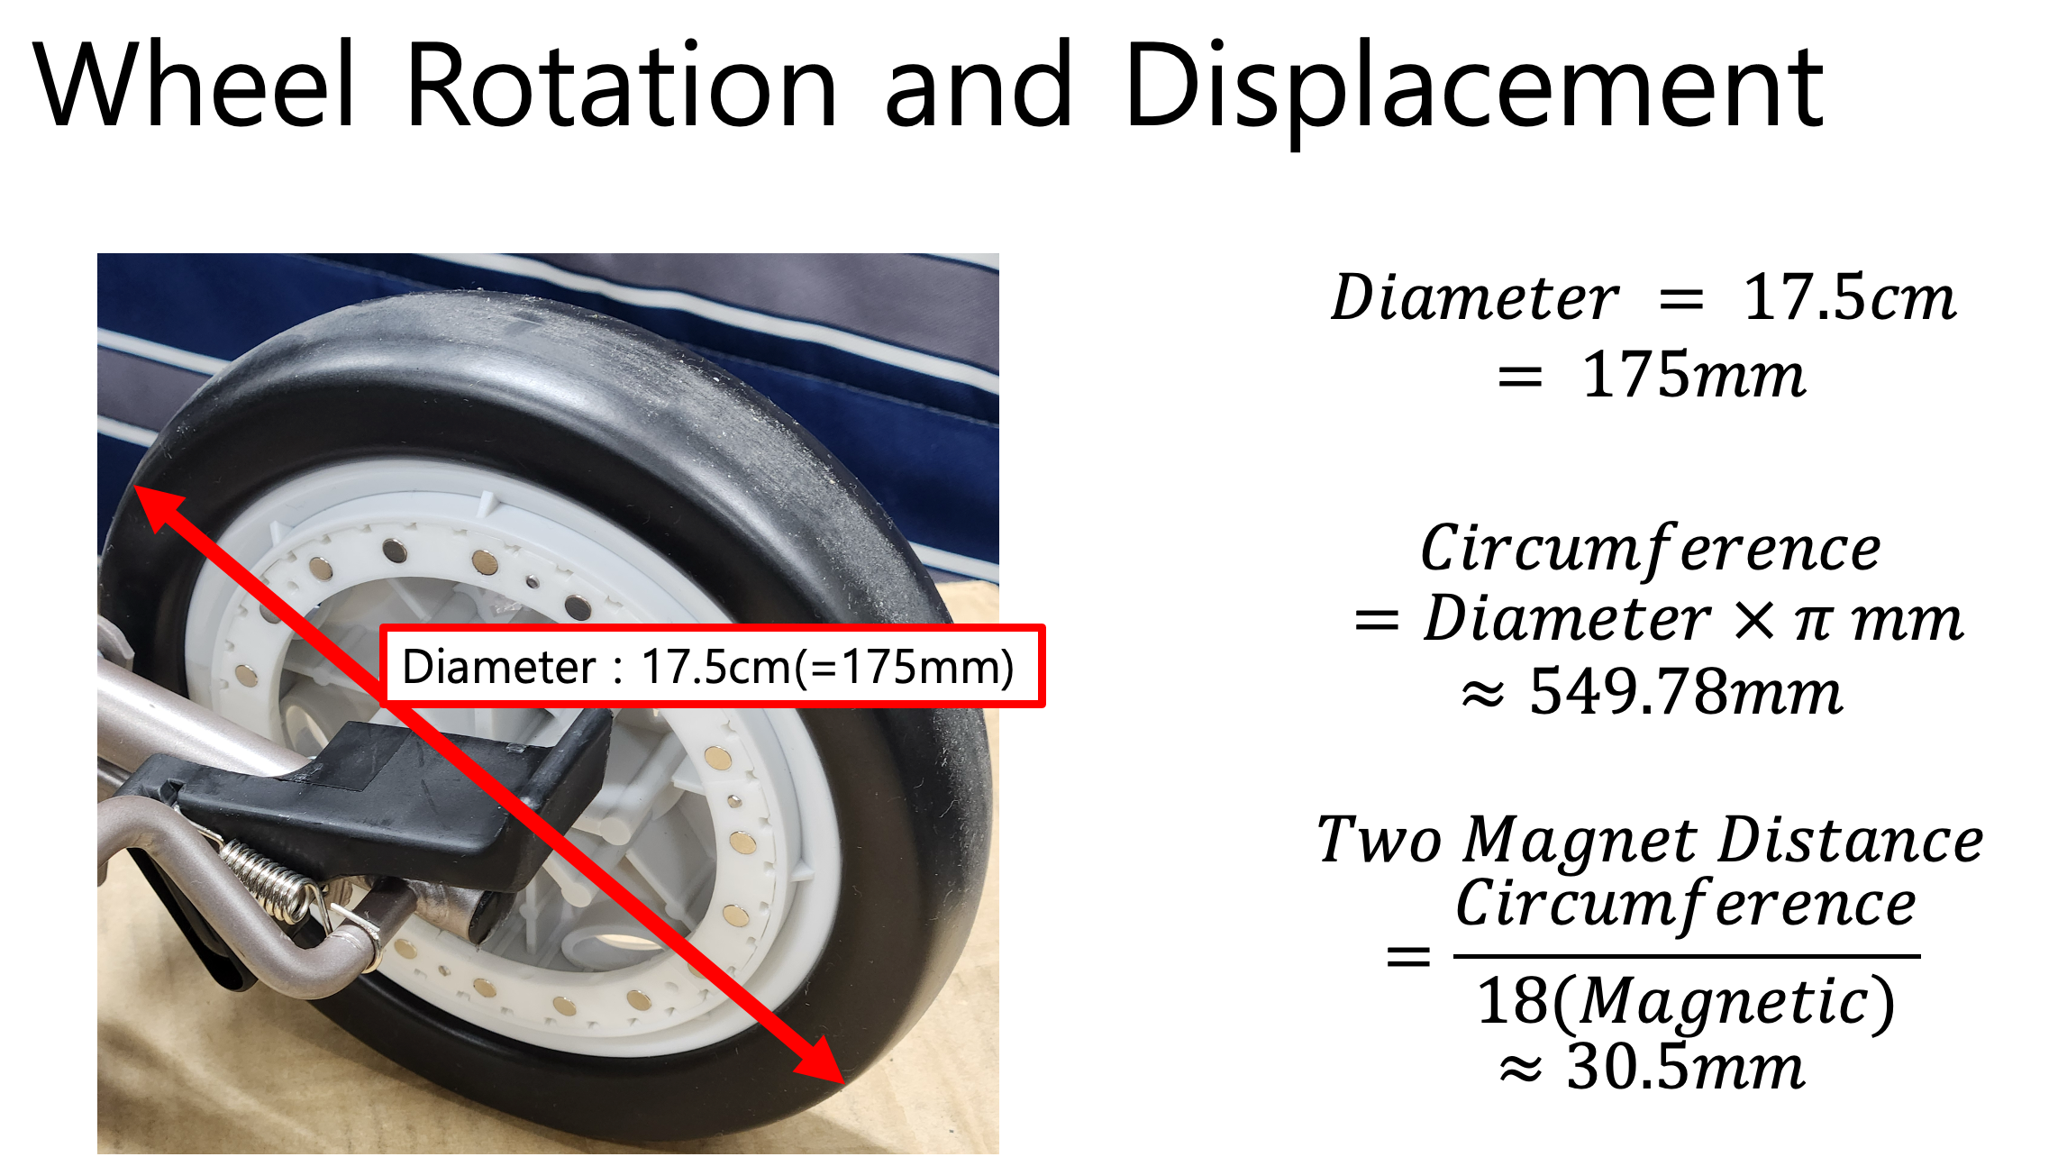
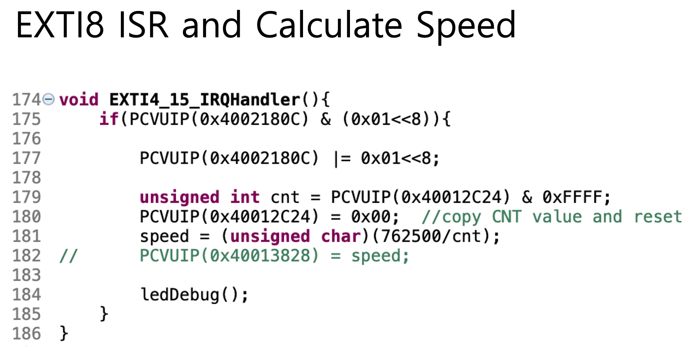
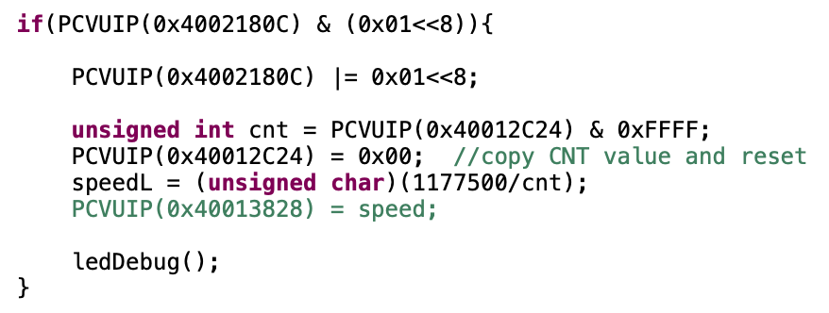
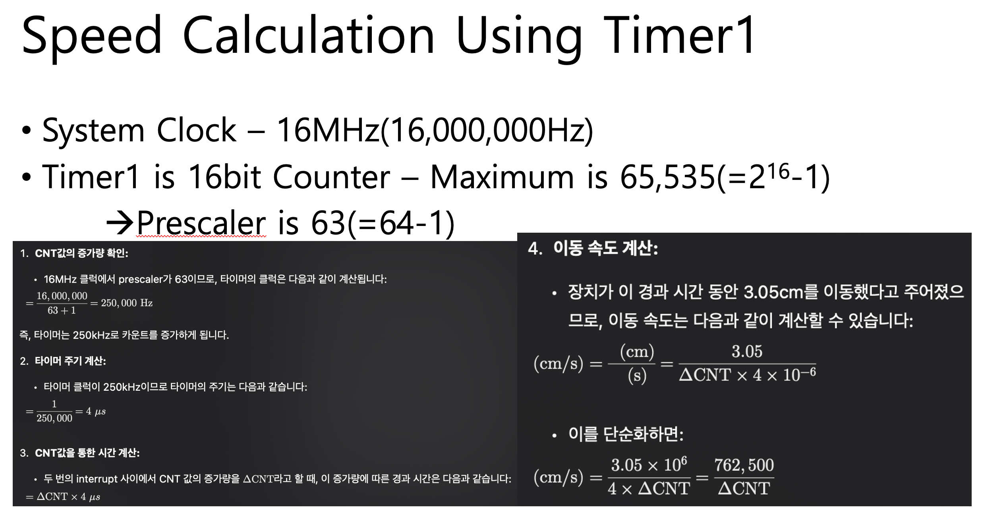
Wheel Speed

Slide 6
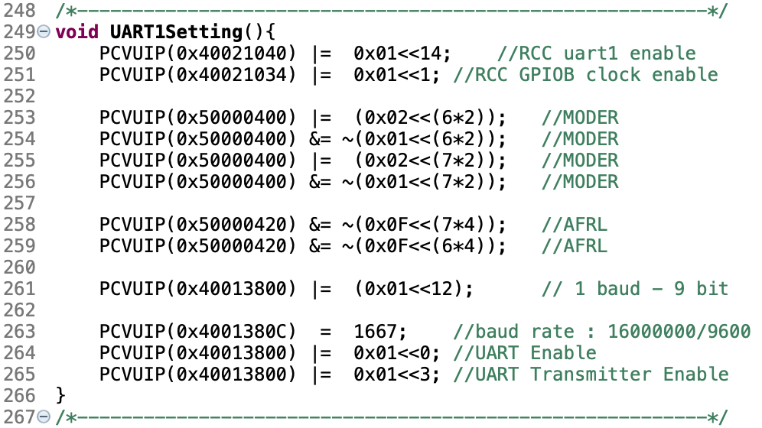
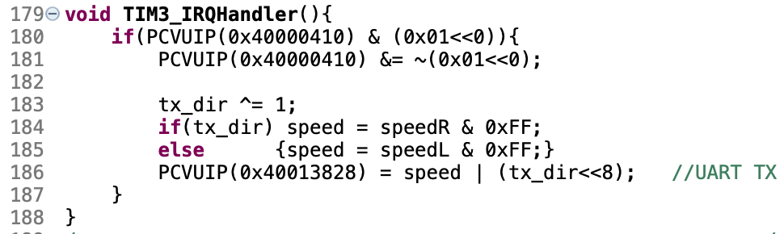
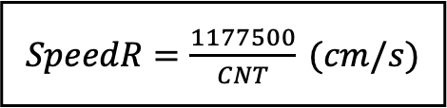
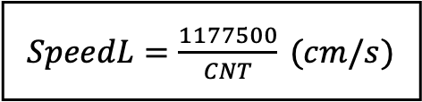
Dual Wheel Speed
STM32G030F6P6
Hall Effect Sensor
(Left Wheel)
PA8
EXTI8
TIM1
TIM14
EXTI7
PA7
Hall Effect Sensor
(Right Wheel)
$SpeedL=\frac{1177500}{CNT}$ $(cm/s)$
$SpeedR=\frac{1177500}{CNT}$ $(cm/s)$
TIM3
RX Period
0,xxxx,xxxx₍₂₎
1,xxxx,xxxx₍₂₎
Arduino Nano
UART1 – TDR (*(unsigned int*)(0x40013828))

Slide 7
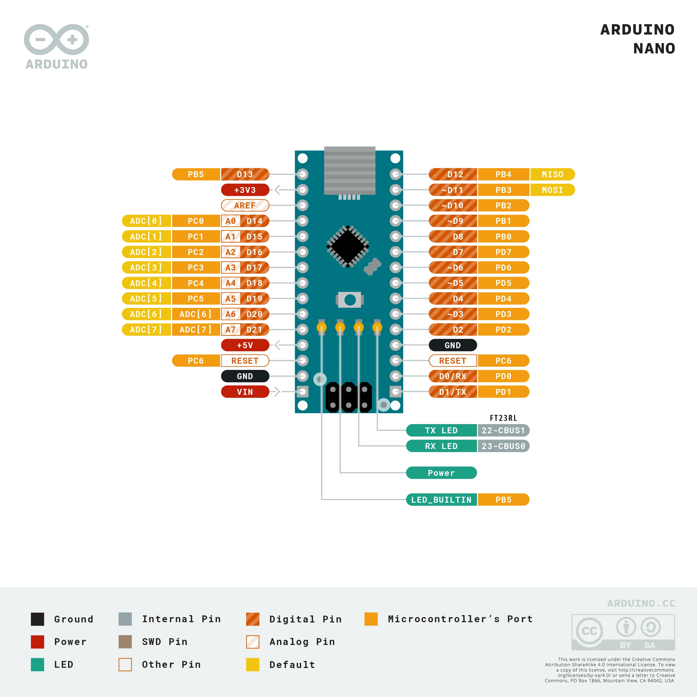
Diagram
Sensitivity Switch
STM32G030F6P6
Motor Wheel Speed
(Virtual UART)
Motor Driver
UART - USB(unused)
Raspberry Pi5
Clock Signal
Dual FSR Matrix Sensor
MPU9250
Gyro Sensor
(I²C)
Analog Data

Slide 8
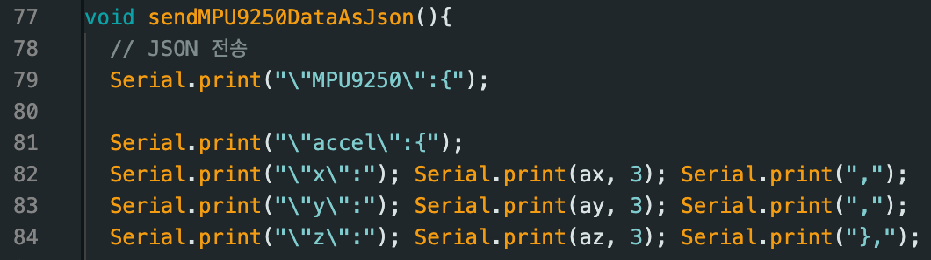
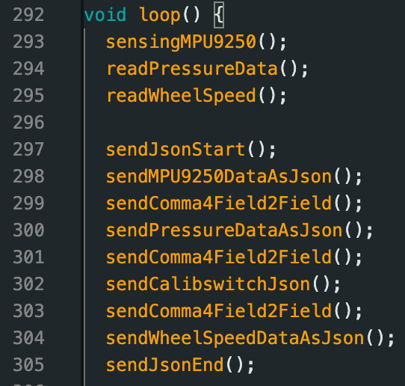
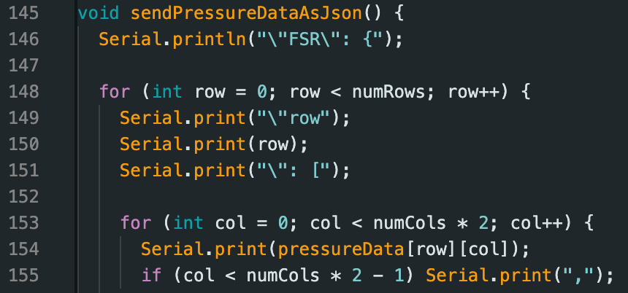
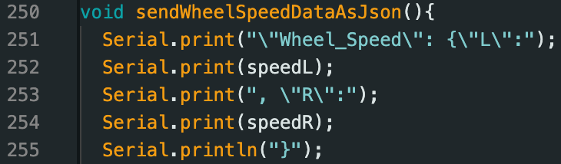
Json Formating

Slide 9
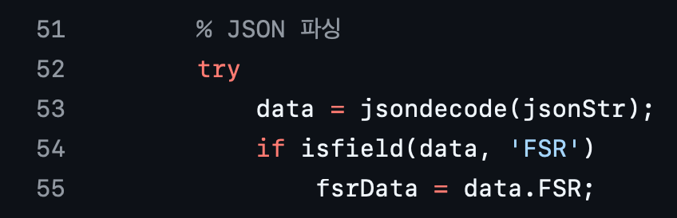
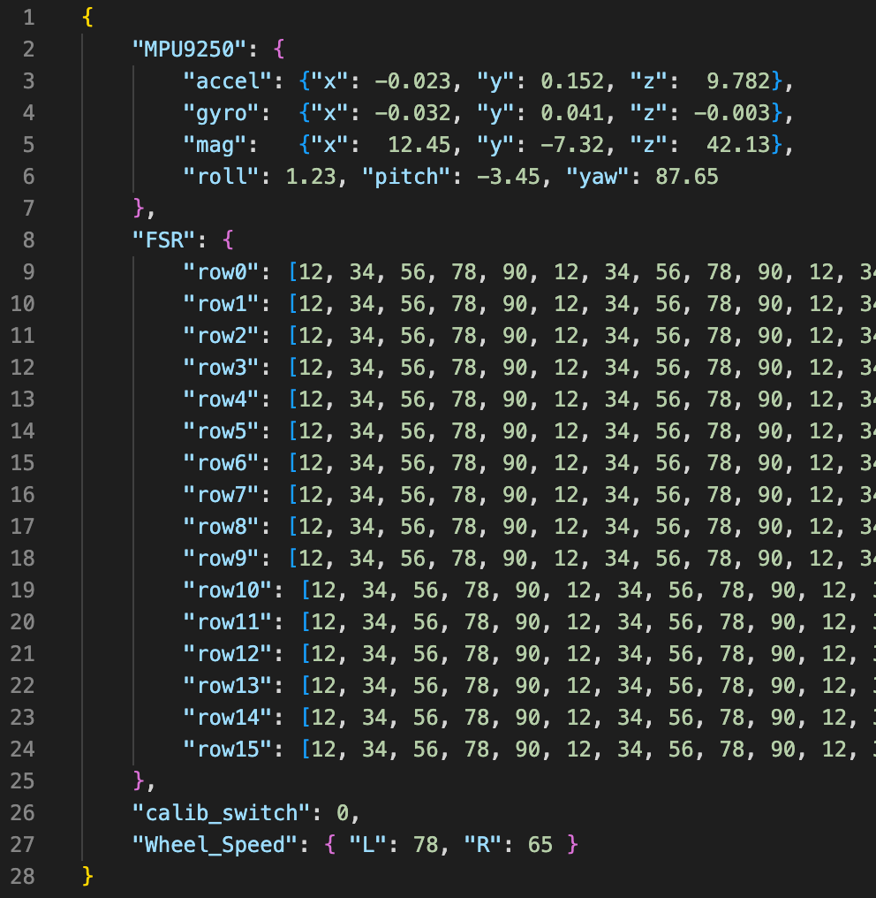
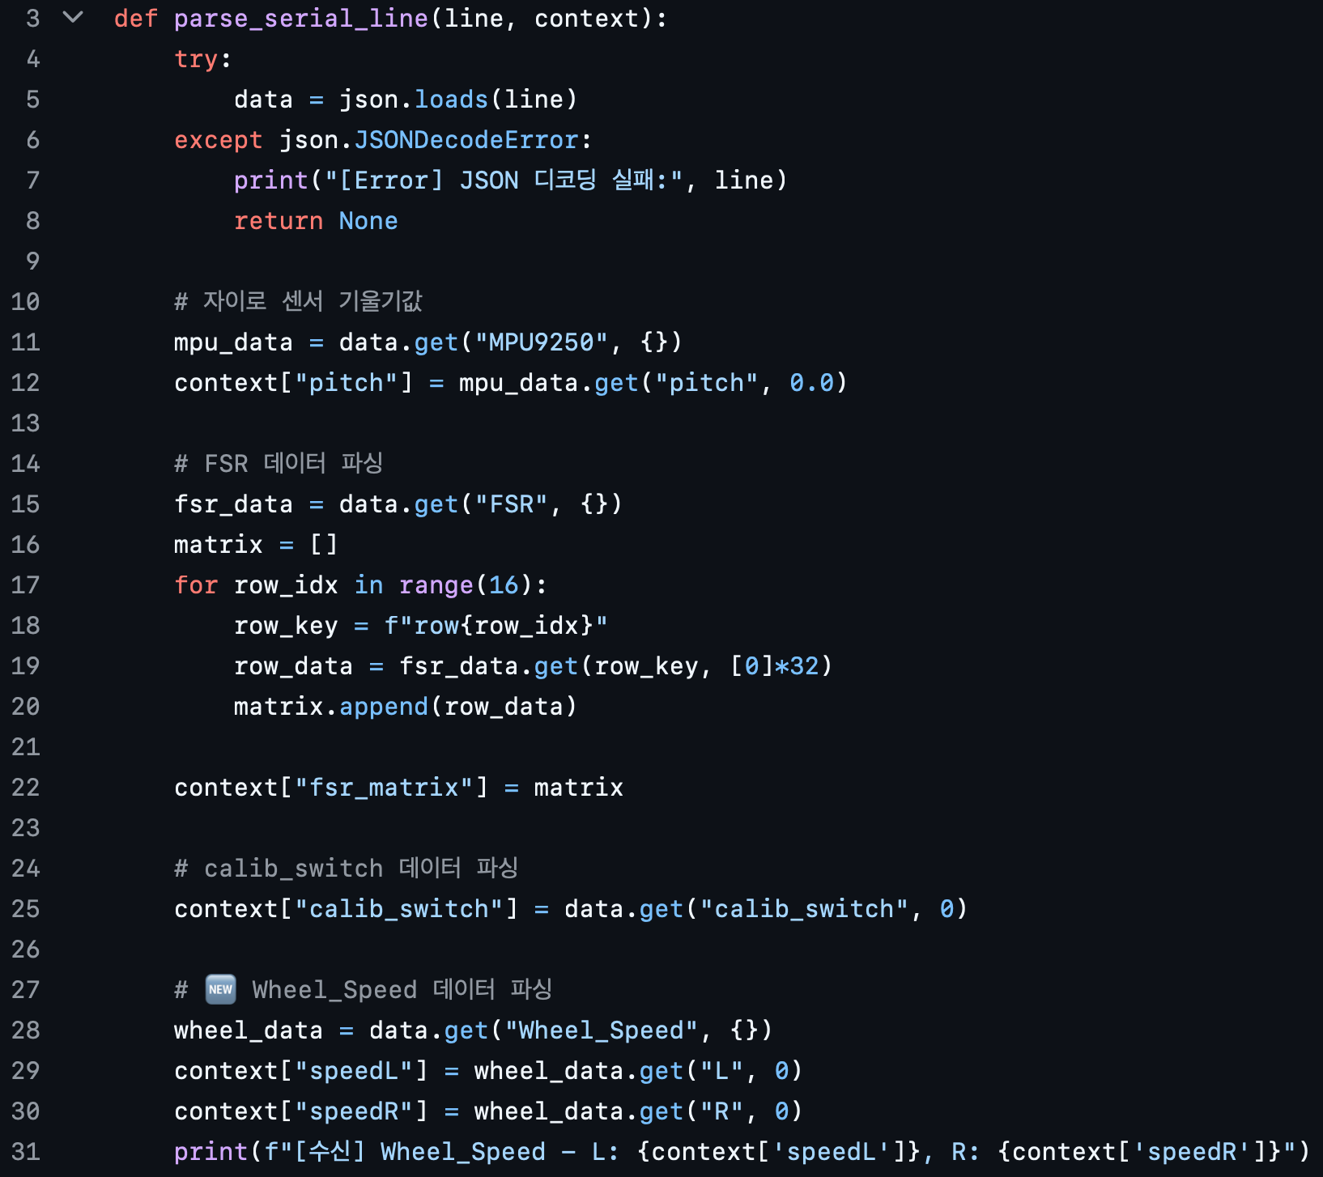
Json Formating

Slide 10
Thank you

